Slide 1
Introduction to Python
And Installation

Slide 2
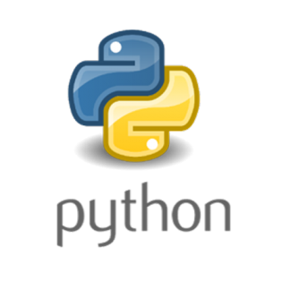
What is Python ?
Python is a powerful multi-purpose, high level, object oriented programming language. It has simple easy-to-use syntax, making it the perfect language for someone trying to learn computer programming for the first time.
Python is widely used in the field of Artificial Intelligence and Web Development.

Slide 3

Python Installation
We are going to install Python with Anaconda. The open-source Anaconda Distribution is the easiest way to perform Python/R data science and machine learning on Linux, Windows, and Mac OS X. With over 11 million users worldwide, it is the industry standard for developing, testing, and training on a single machine.
Anaconda installation steps with proper illustrations are discussed in further slides.

Slide 4

Step 1:
Go to Anaconda official Website (https://www.anaconda.com/), click on Downloads in the top right corner.

Slide 5
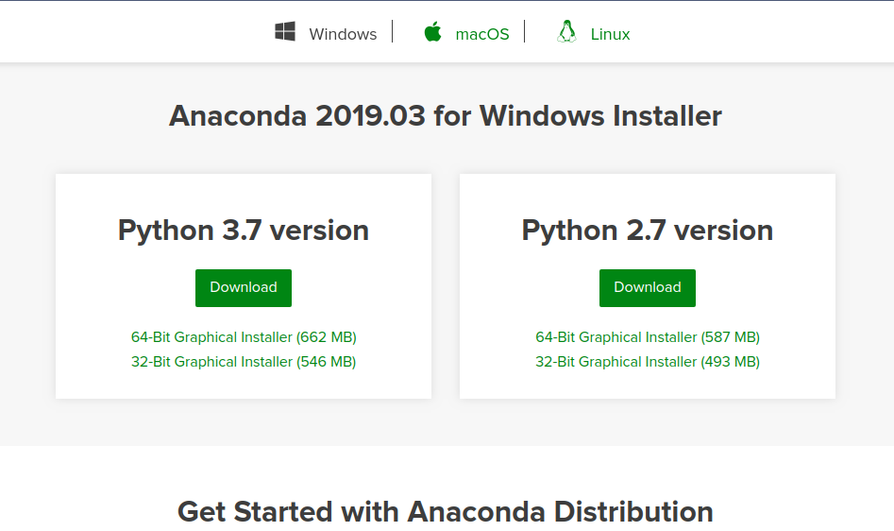
Step 2:
Scroll down on the new page and you will find download options. Choose your platform(Windows/Linux/Mac) and click download. You can choose between 64-Bit Installer and 32-Bit Installer according to your system specifications.

Slide 6
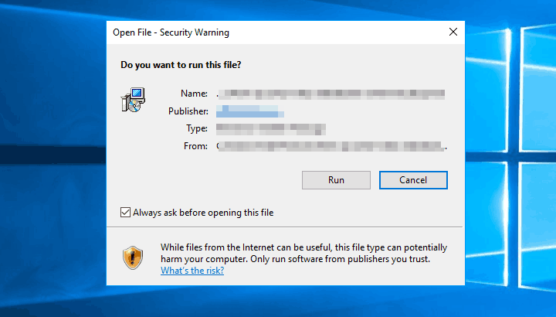
Step 3:
Now double click on the downloaded .exe file and a security warning pop-up window may appear, click run on it.

Slide 7
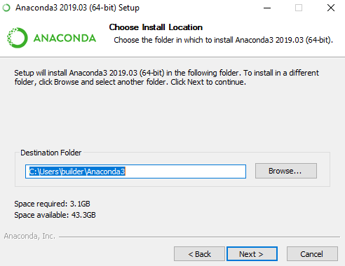
Step 4:
4.1 : Click Next, read the licencing terms and click agree.
4.2 : Select an install for “Just me” and click next. Now choose an installation directory and click next.

Slide 8
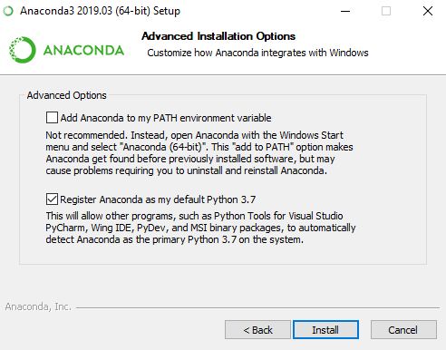
Step 5:
Now you have to choose whether to add Anaconda to your PATH environment variable(not recommended). Check “Register anaconda as my default Python” and click install.Also click on Add anaconda to my path Environment Variable

Slide 9
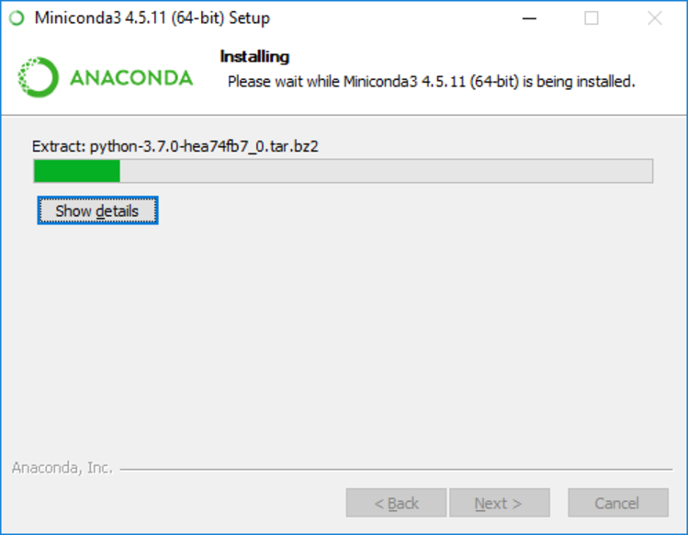
Step 6:
The Anaconda should
be installing now.

Slide 10
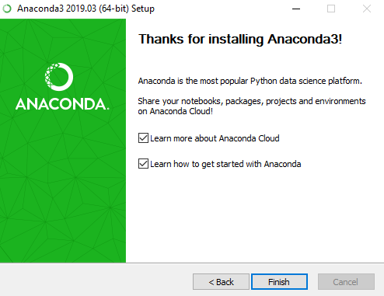
Step 7:
After a successful installation you will see the “Thanks for installing Anaconda” dialog box.

Slide 11
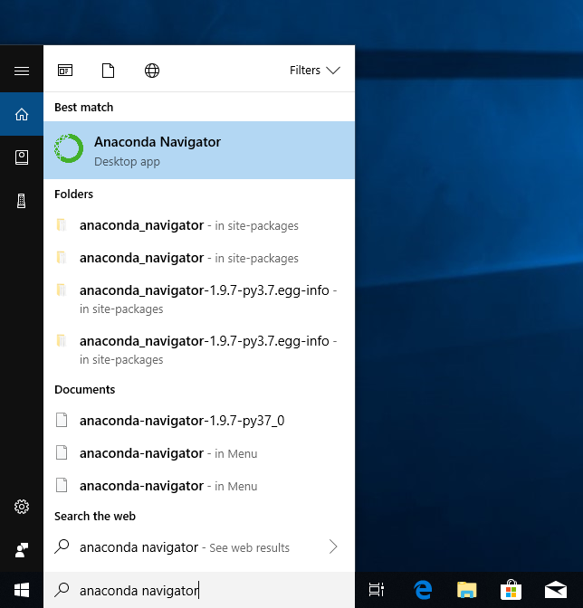
Running Anaconda
From Windows Start menu, select the shortcut Anaconda Navigator from the Recently added or by typing “Anaconda Navigator”. If Navigator opens, you have successfully installed Anaconda.

Slide 12
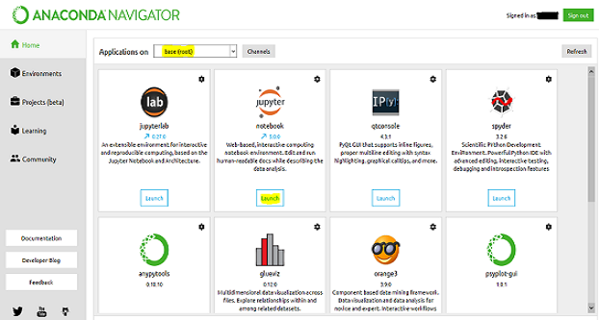
Running Jupyter Notebook from Anaconda
Anaconda Navigator will take some time in launching for the first time (It is recommended to restart your PC before running Anaconda for the first time).

Slide 13
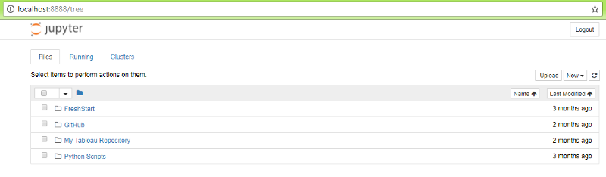
Running Jupyter Notebook from Anaconda
Click on the Launch icon of Jupyter Notebook and the Jupyter Notebook Dashboard will open in your default browser.

Slide 14
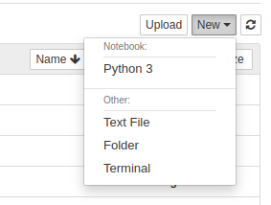
Running Jupyter Notebook from Anaconda
Now click on the New button in top right and select Python3 from drop down menu.

Slide 15
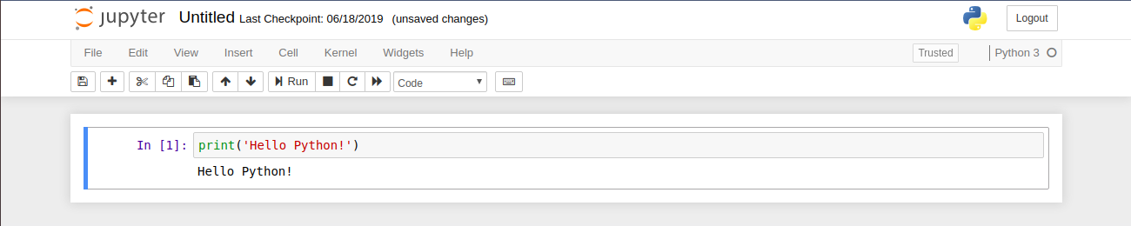
Running Jupyter Notebook from Anaconda
A fresh Jupyter Notebook will open in the new tab. Now write a few lines of code and press CTRL+ENTER to run it. And Yeah, you’ve run your first line of Python.

